Slide 1
Convolutional neural networks: state of the art technique for image classification
By: Joey Silburt,
August 12, 2019

Slide 2
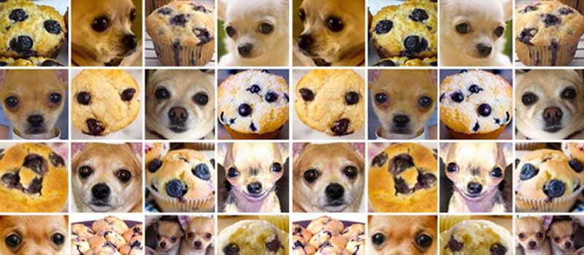
Classification of images: we’re gonna be able to do this!

Slide 3
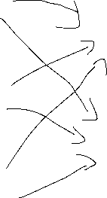
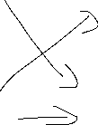
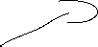
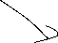
Recall: Neural Networks are a great way to combine 1D data
First hidden layer
“interactions”
Second hidden layer
“interactions”
5
Output layer
3
prediction
1

Slide 4

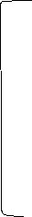
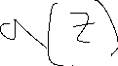
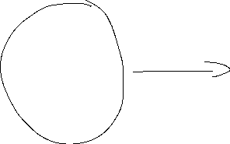

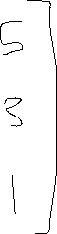
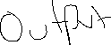
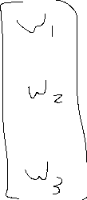
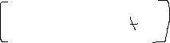
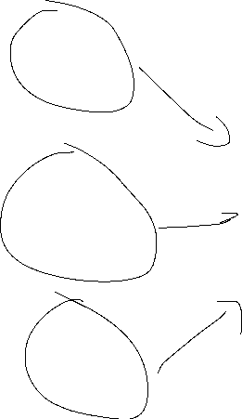
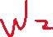
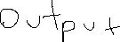
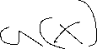
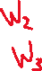
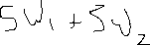

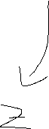
Recall: Neural Networks are a great way to combine 1D data
e.g., ReLu, Sigmoid, TanH
One value

Slide 5
Recall: Neural Networks are a great way to combine 1D data
First hidden layer
“interactions”
Second hidden layer
“interactions”
5
Output layer
3
prediction
1

Slide 6
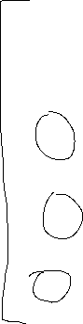
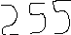
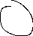
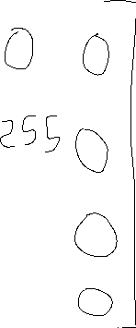
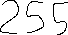
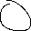
How to we retrieve data from images? – what is an image?
Grayscale image

Slide 7
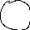
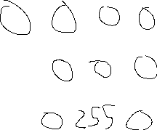
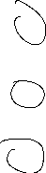
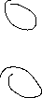
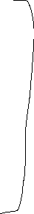
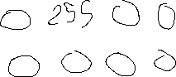
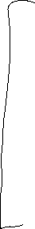
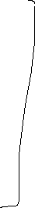
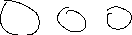
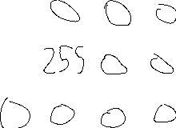
Coloured images are 3 channels of pixel intensity (RGB)
Red
Green
Blue

Slide 8
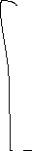
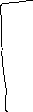
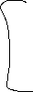
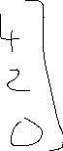
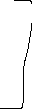
Convolutions are a way to combined 2D and 3D data.
3x3 pixel image
Filter
*
3(2) + 0(1) + 2(0) + 1(1) = 7
0(2) + 4(1) + 1(0) + 2(1) = 6
2(2) + 1(1) + 1(0) + 0(1) = 5
1(2) + 2(1) + 0(0) + 0(1) = 4

Slide 9
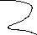
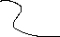

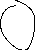
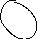
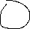

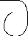
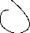
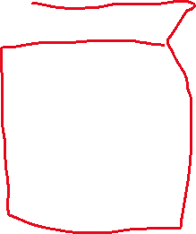
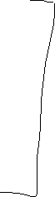
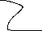
Convolutions in 3D

Slide 10

A filter is a kind of “feature” helps identify aspects or features in a picture. E.g., “horizontal line detection”

Slide 11

“vertical line detection”

Slide 12
Filters are the “features” for a CNN. Can have multiple stackable filters
“feature map”
filter1
*
filter2
filter3
Weights for filters are learned by the network

Slide 13


A full CNN layer
Resulting feature maps
filter
We apply an activate function
to our feature maps

Slide 14


More on filters - stride
Filter Stride = 1
i.e., shift filter over by 1
Filter Stride = 2
i.e., shift filter over by 2

Slide 15

Padding: a method to not reduce the feature map size.
Temporarily add a series of 0s so that the
convolution doesn’t overly reduce the size
An example of a “Same convolution”
i.e., the resultant feature map is the same dimensions as the original feature map.
“valid” convolution = no padding

Slide 16

Pooling: a method to “consolidate features”
Note: Average pooling = average all values in window

Slide 17
“Common” to follow a convolutional layer with a pooling layer
NO ACTIVATION FOLLOWING POOLING

Slide 18
Making a classification decision after a CNN, flatten the CNN, add an output layer

Slide 19

Flattening = unspooling a matrix into a 1d vector
Use normal NN layers

Slide 20
Putting it all-together, as you move through the network, you will “condense” information into smaller and smaller matrices.
Amount of deflation is governed by:
Convolutional Layers:
Convolution with a filter of learned weights, layer accompanied with activation.
Filter window size (i.e. 2x2, 3x3)
Stride size (i.e., stride = 1, 2, 3; >stride = greater reduction)
Padding
Pooling Layers
No activation
Max pooling: pick the largest number in a window size (i.e. 2x2, 3x3)
Average pooling: average the values in a window size.
Window size (i.e. 2x2, 3x3)
Stride size (i.e., stride = 1, 2, 3; >stride = greater reduction)
Padding

Slide 21

Putting it all together, AlexNet, a leap in CNNs.
Increased feature complexity
Lines/edges
“Facial features”
Some intuitions.. As you get deeper,
More filters (i.e. features),
Smaller window size

Slide 22

Common regularizations for CNNs: dropout

Slide 23


ResNets, Generation 2 of CNNs. residual network = a skip connection; facilitates deeper networks

Slide 24
What are CNNs learning?
Learn the various filter features (which are the weights)
Relate these filter features to some set of classification outcomes.

Slide 25

CNNs can be difficult to train, let’s use someone else’s network! i.e. Transfer Learning
Intuition, we don’t need to reinvent the wheel, even if our particular case is something obscure, i.e. recognizing cancer cells, we can use features already developed by large networks.
i.e., we don’t need to relearn how to recognize vertical and horizontal edges, we only need to relearn how those features can get recombined into a cancer cell vs. a non-cancer cell.
Only need to retrain this
FEATURE LEARNING PHASE

Slide 26

Other concepts in building CNNs: Data augmentation
Getting enough images can be very challenging, therefore, we can artificially generate new images by cropping, or altering our existing image dataset.

Slide 27

Food for thought, generalizing over Data augmentation.
I was at a lecture of a CNN developed to detect tumour cells. It was very impressive work.. However it turns out that…
The CNN was trained on ~10⁶ images.
However, there were only ~100 individual tumours.
10⁶ images were generated from cropping sub-images from the larger tumour.
This seems like a good idea, but how generalizable is this really???
if intra tumour variability >> inter tumour variability, we are basically overfitting over a small set of tumour characteristics.
I have no solution, and am not even sure if other’s agree with me… this is just something that I think about

Slide 28

Moving forward with CNNs: object detection

Slide 29

Moving forward with CNNs: Segmentation

